Slide 1
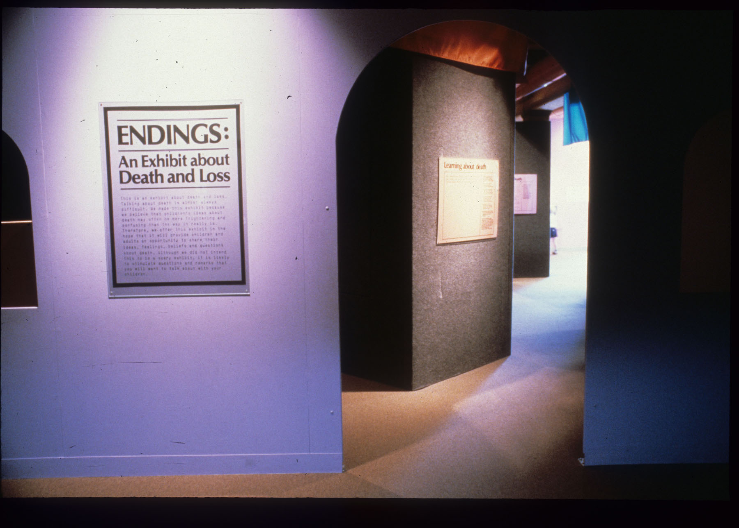
ENDINGS: An Exhibit about Death and Loss
Designer Signe Hanson created a set-back doorway entry so that visitors would be making a conscious choice to enter.

Slide 2
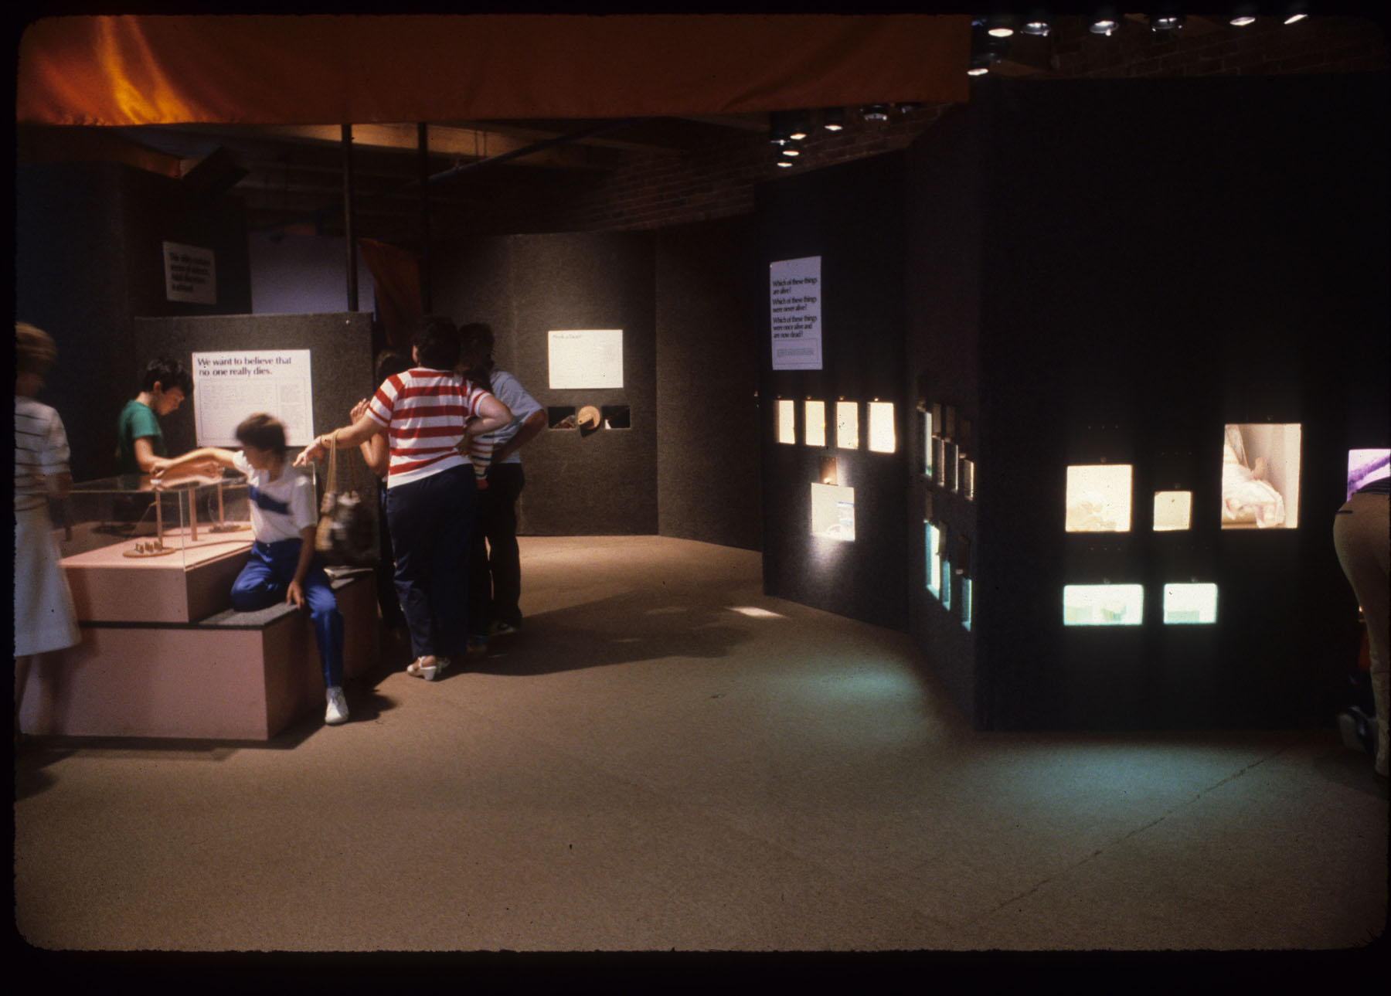
Inside the exhibit
To encourage focused viewing and privacy, exhibit designers created a muted environment with objects highlighted.

Slide 3
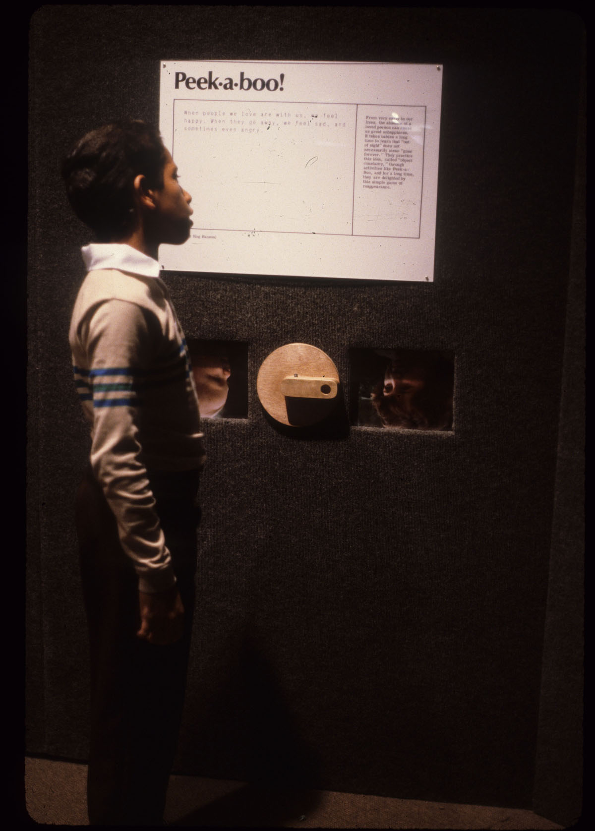
Throughout the exhibit, two levels of text describe the content: one for adults and one for younger readers.
Peek-a-boo!
When people we love are with us, we feel happy. When they go away, we feel sad and sometimes even angry.
From very early in our lives, the absence of a loved person can cause us great unhappiness. It takes babies a long time to learn that “out of sight” does not necessarily mean “gone forever”. They practice this idea, called “object constancy” through activities like Peek-a-boo”, and for a long time they are delighted by this simple game of reappearance.

Slide 4
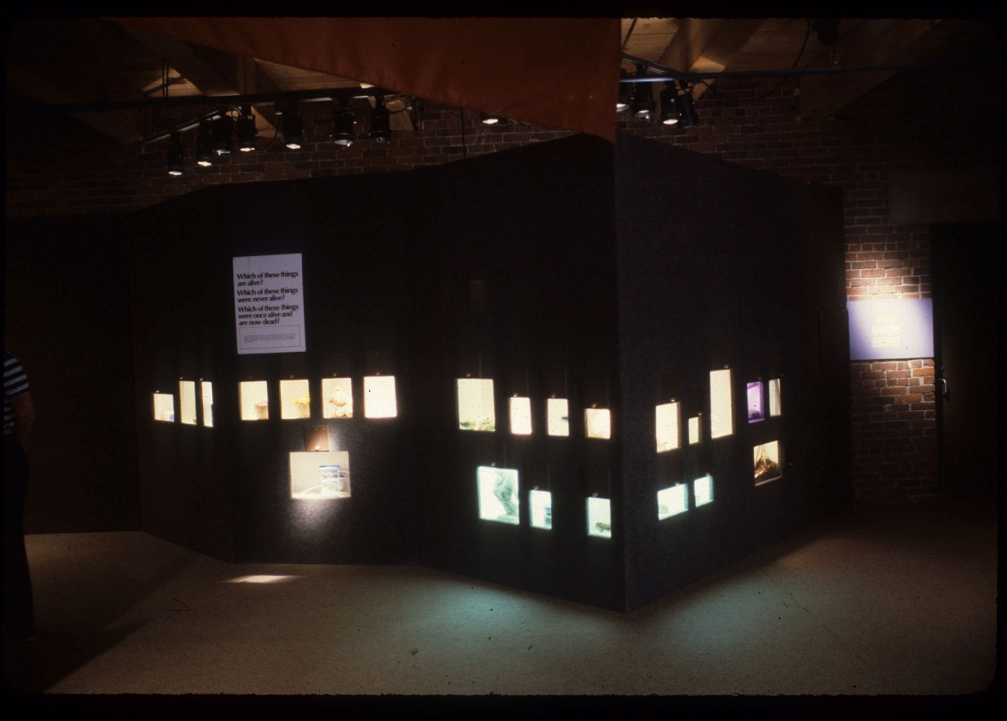
Alive, Never Alive or Dead?
Which of these things
are alive?
Which of these things
were never alive?
Which of these things were once alive and are now dead?

Slide 5
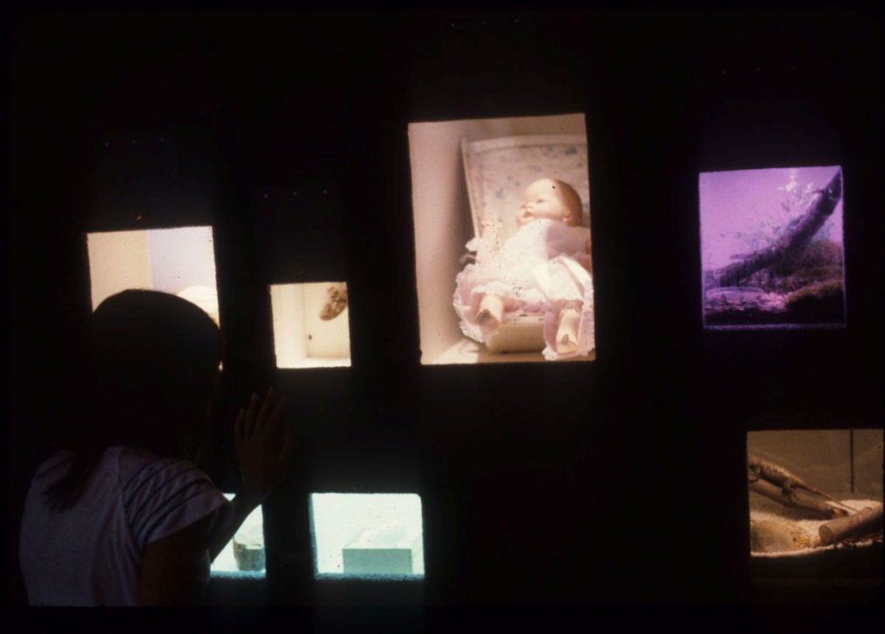
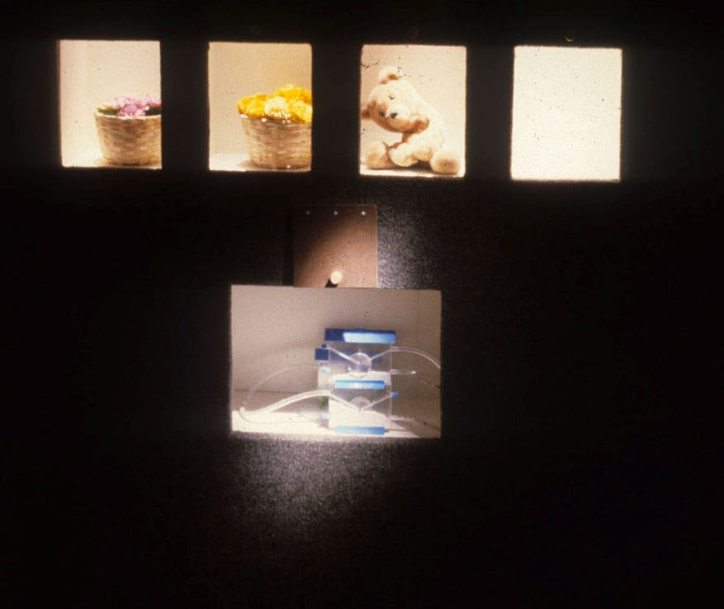
Alive, Never Alive or Dead?
Some things look alive which are not, such as artificial flowers and toy animals.
Some things, such as flowing water, move as though they were alive, but they are not.

Slide 6
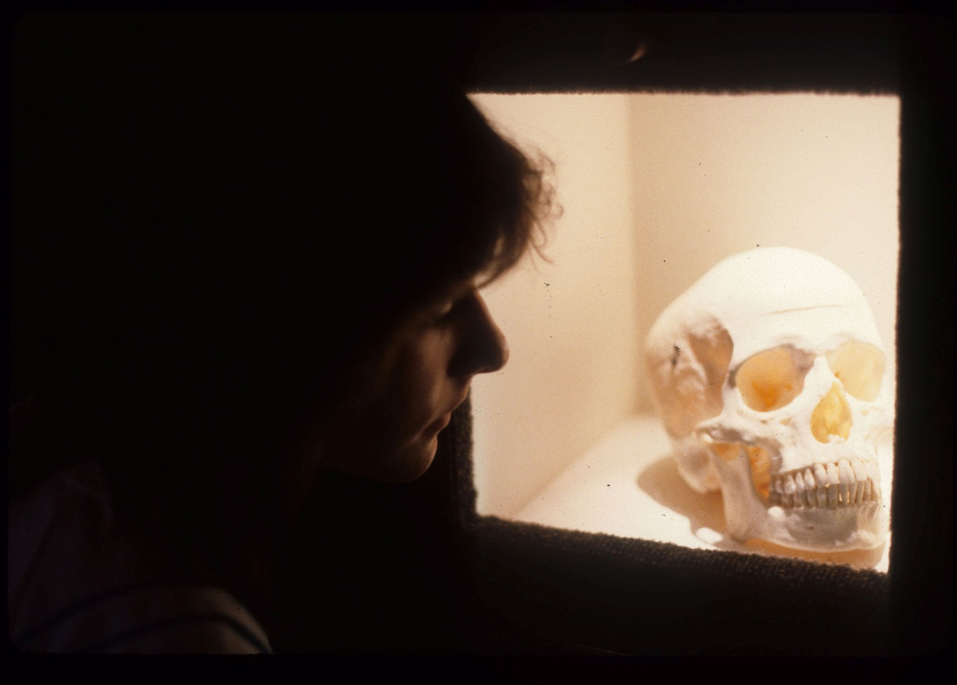
Once alive; now dead.

Slide 7
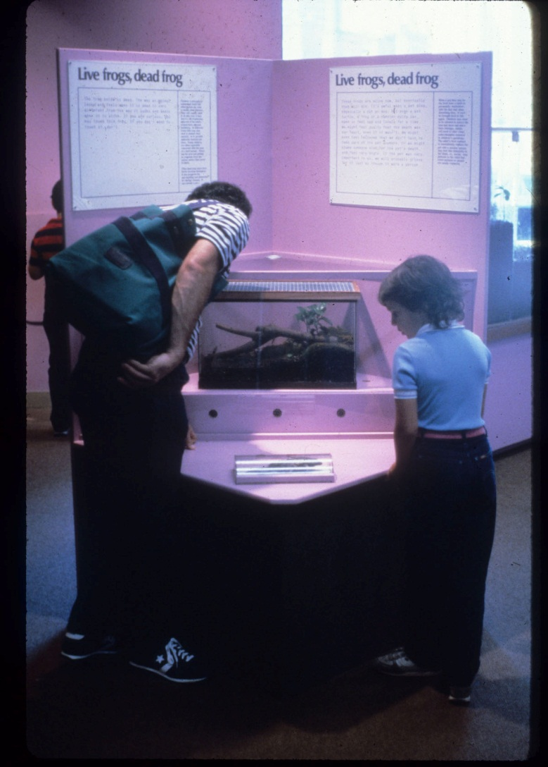
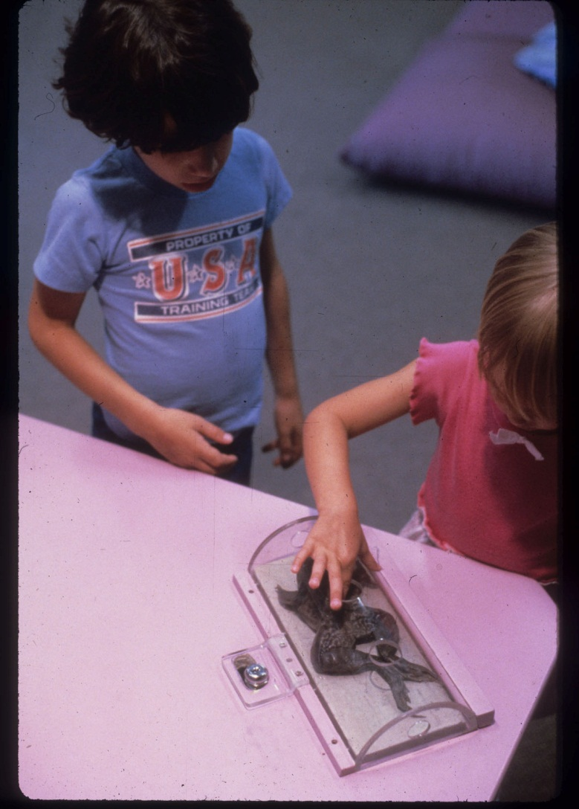
Live frogs, dead frog.
A popular part of the exhibit compared a terrarium of living frogs with a dead frog visitors could touch.

Slide 8
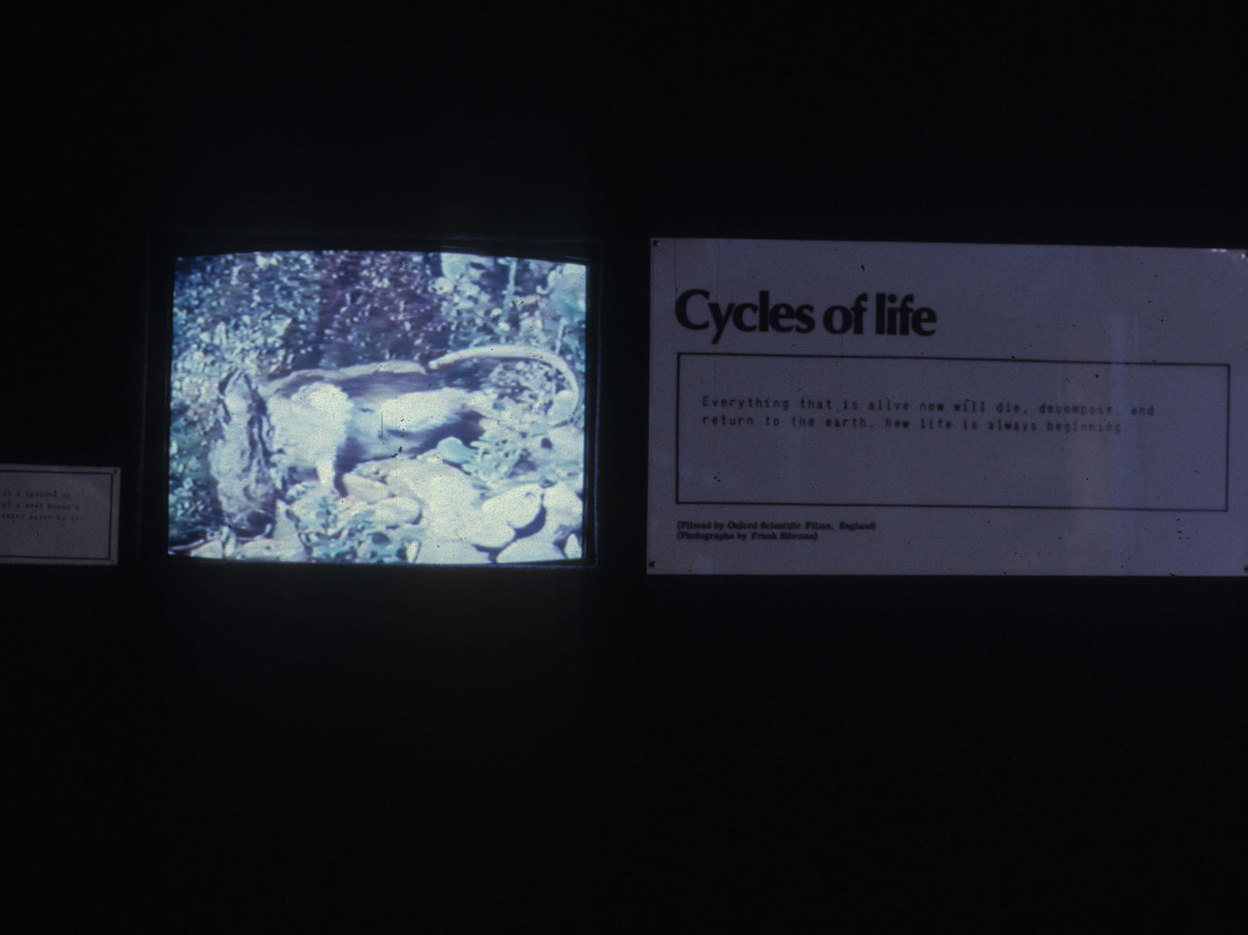
Cycles of life
Everything that is alive now will die, decompose and return to the earth. New life is always beginning.
In this video the body of a dead mouse is shown breaking down, aided by the activity of bacteria and carrion insects.

Slide 9
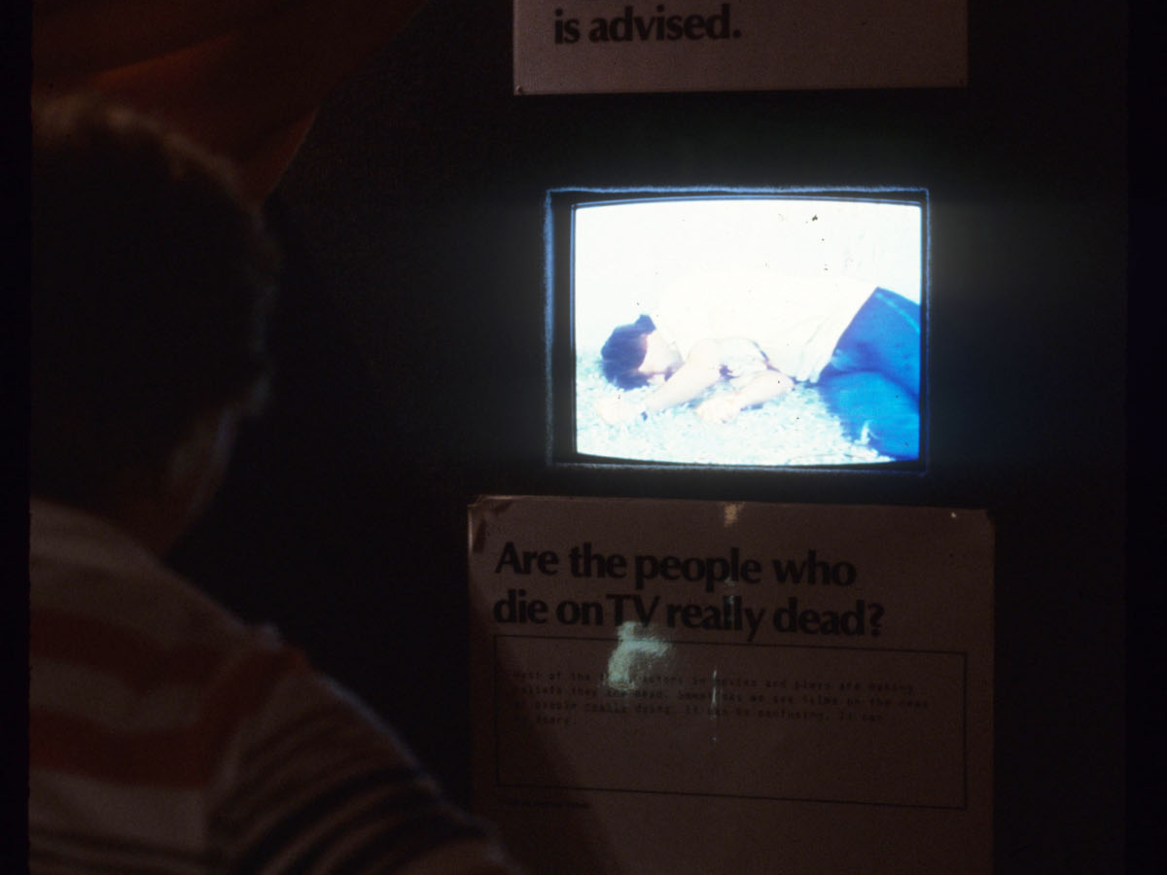
Are the people who die on TV really dead?
This video shows actors performing death scenes and newsreels describing real deaths. A note to parents advised them to view with their children and to help them understand the issues.

Slide 10
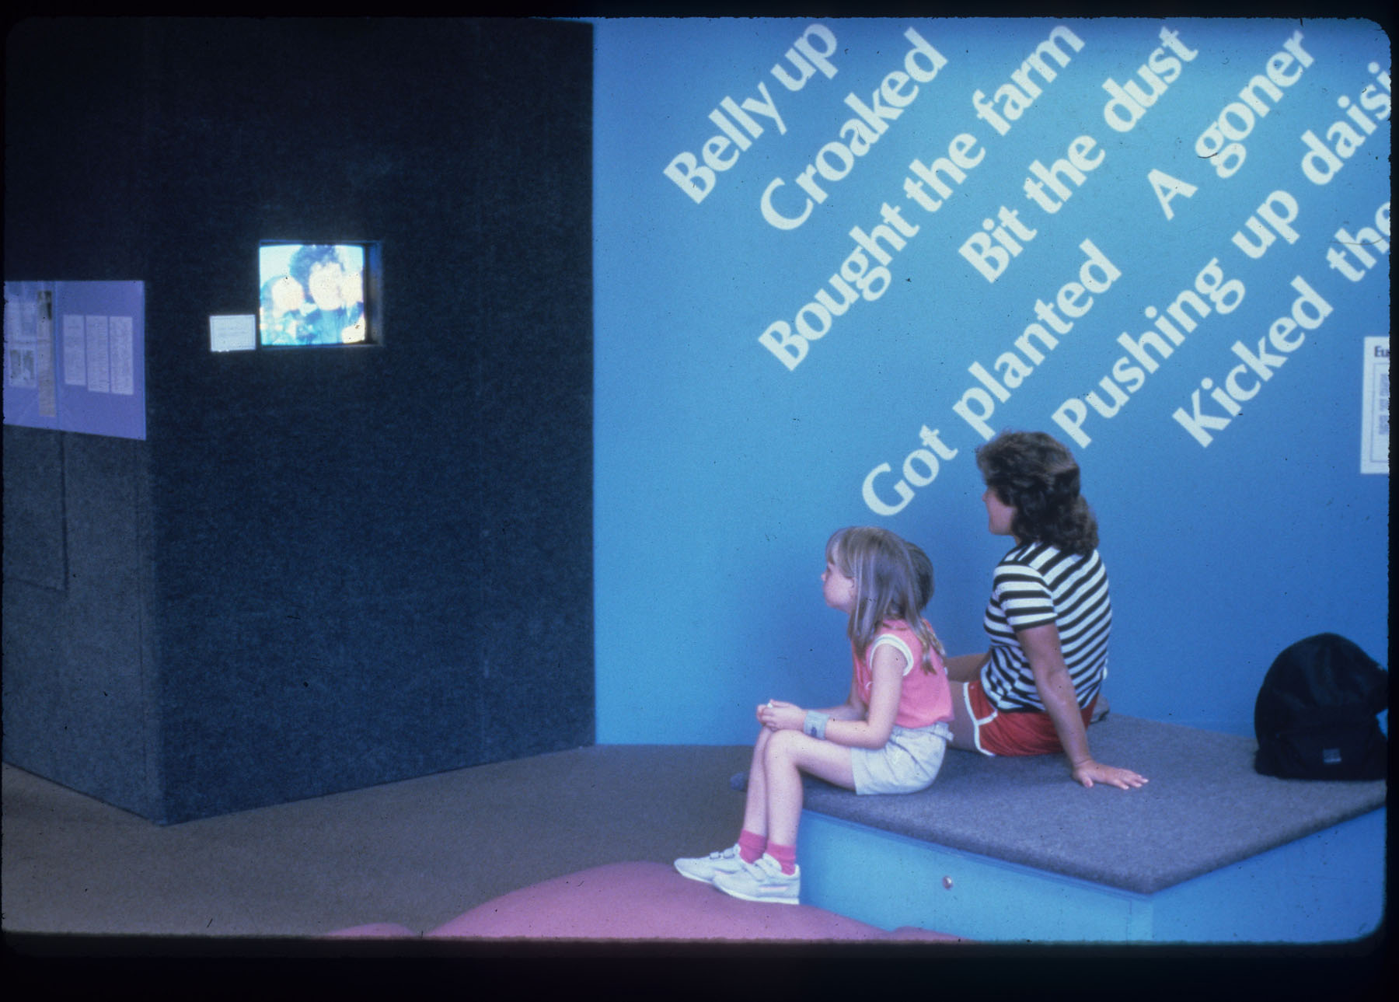
Feelings and words about death.
Another video shows puppets discussing their feelings about loss. The word wall introduces some of the humorous ways we deal with our feelings.

Slide 11
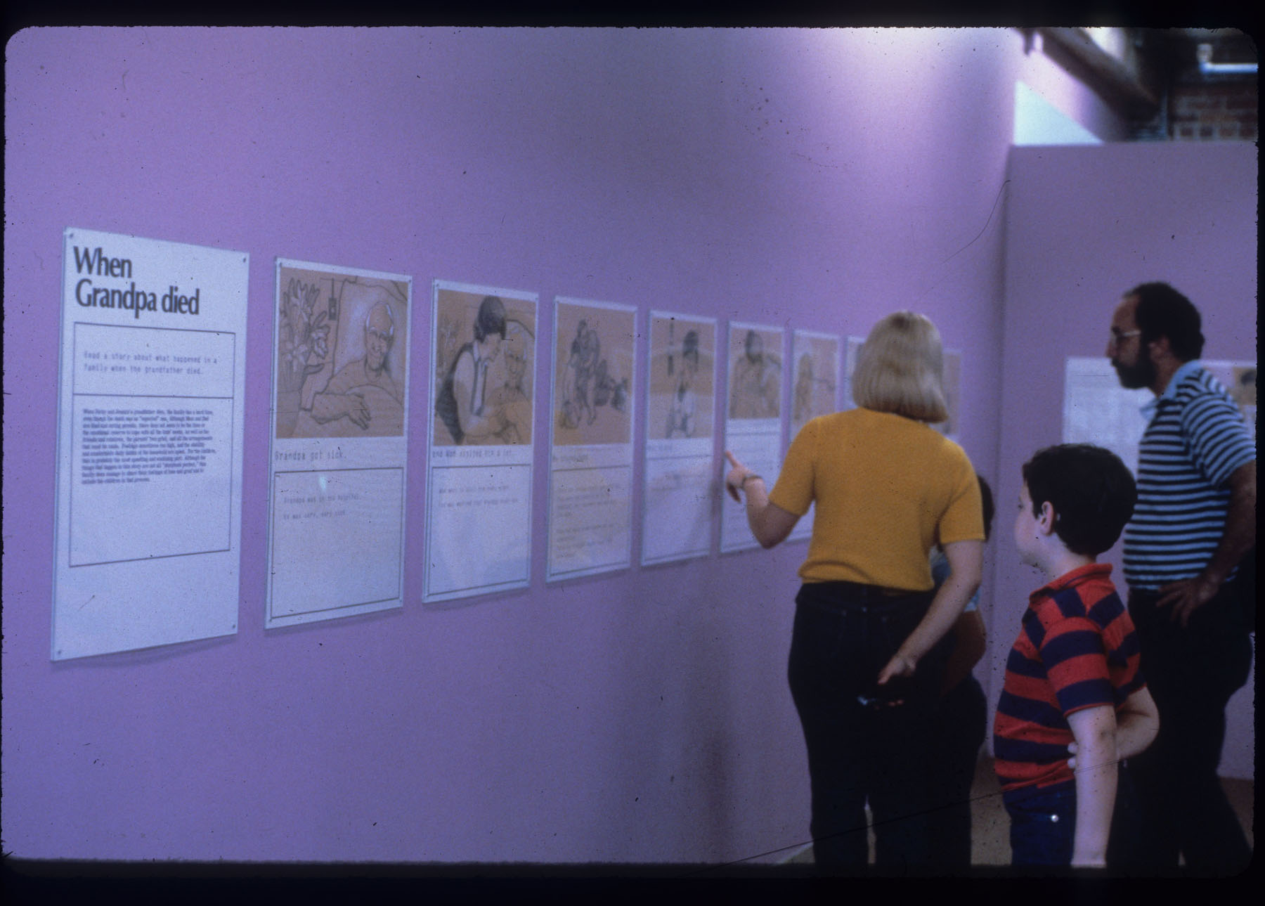
When Grandpa died
This story, illustrated by Signe Hanson, describes a young boy’s sorrow and confusion on the death of his grandfather. The text below the story helps adults interpret and explain the child’s feelings.

Slide 12
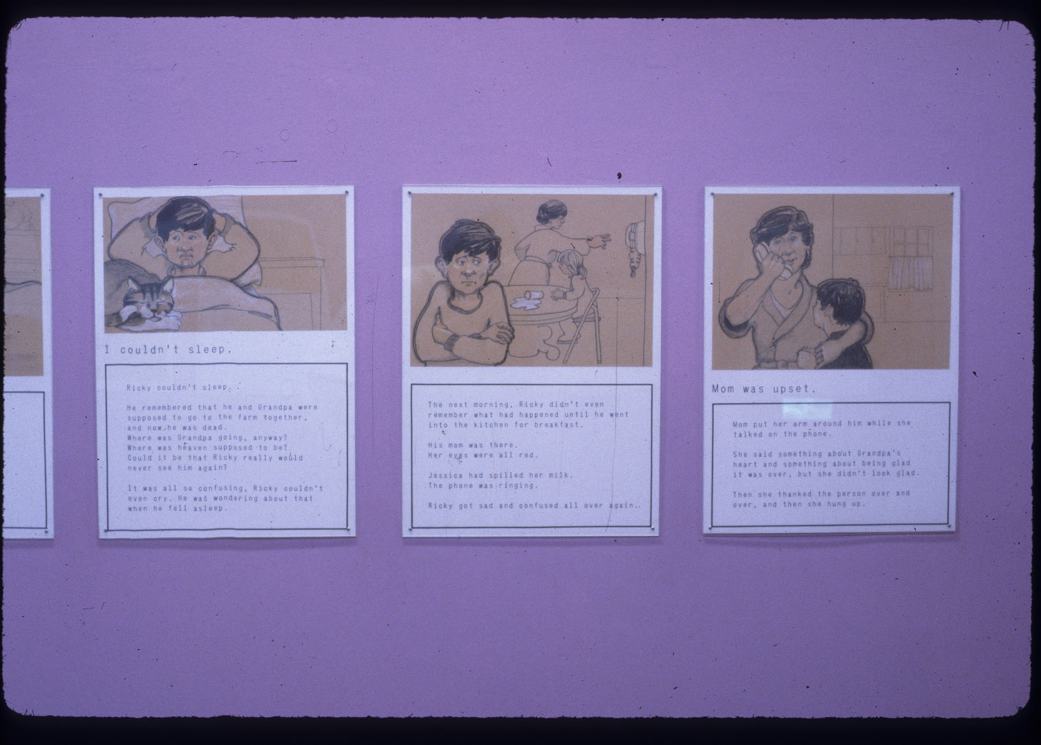

Slide 13
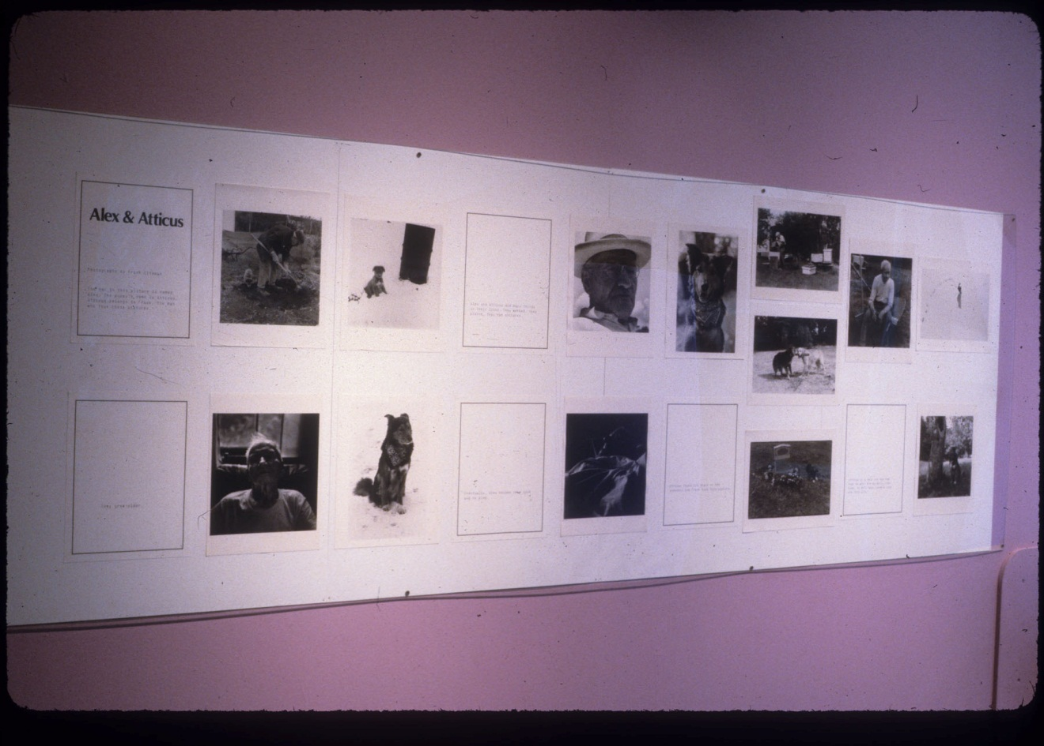
Alex & Atticus
Photographer Frank Siteman shared the story of his dog Atticus whose love for their neighbor Alex continued through his final illness and to his gravesite.

Slide 14
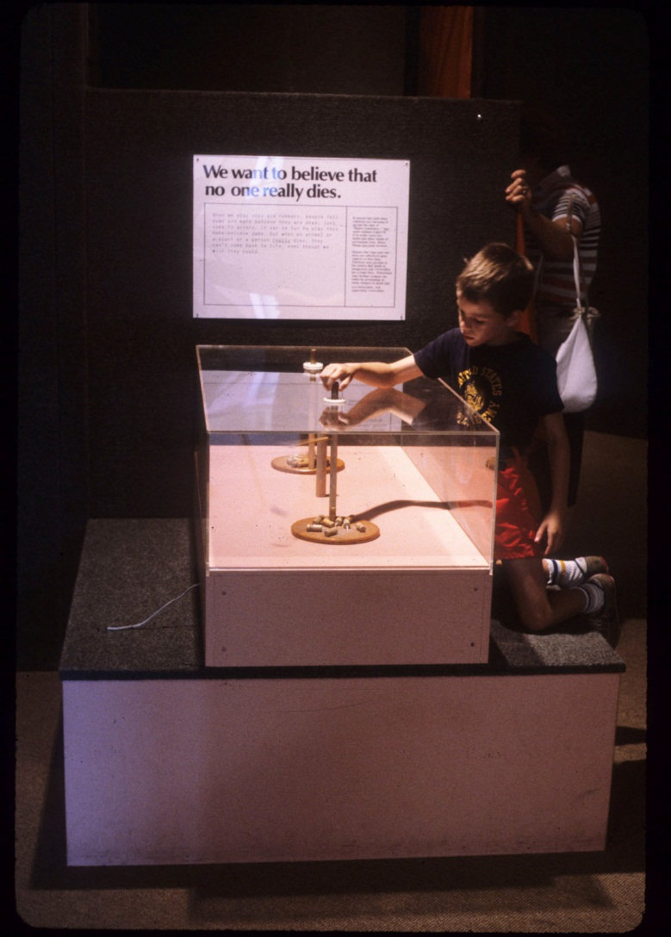
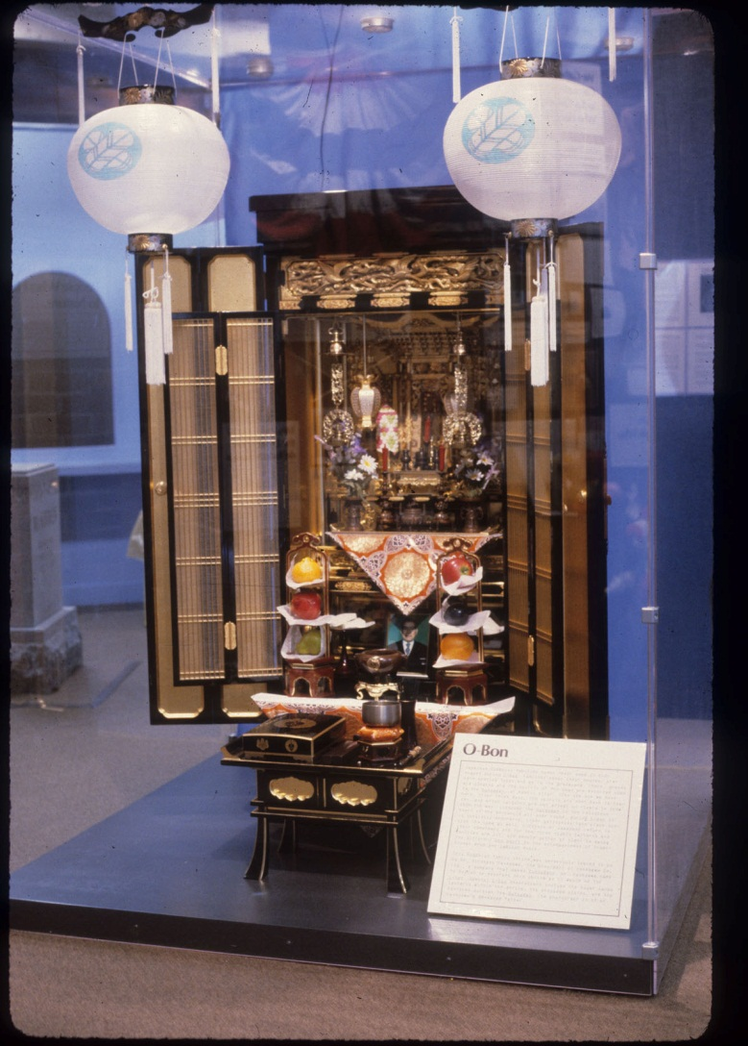
We want to believe that no one really dies.
This exhibit highlighted ideas about death from several religions as well as games and traditions on themes of death.

Slide 15
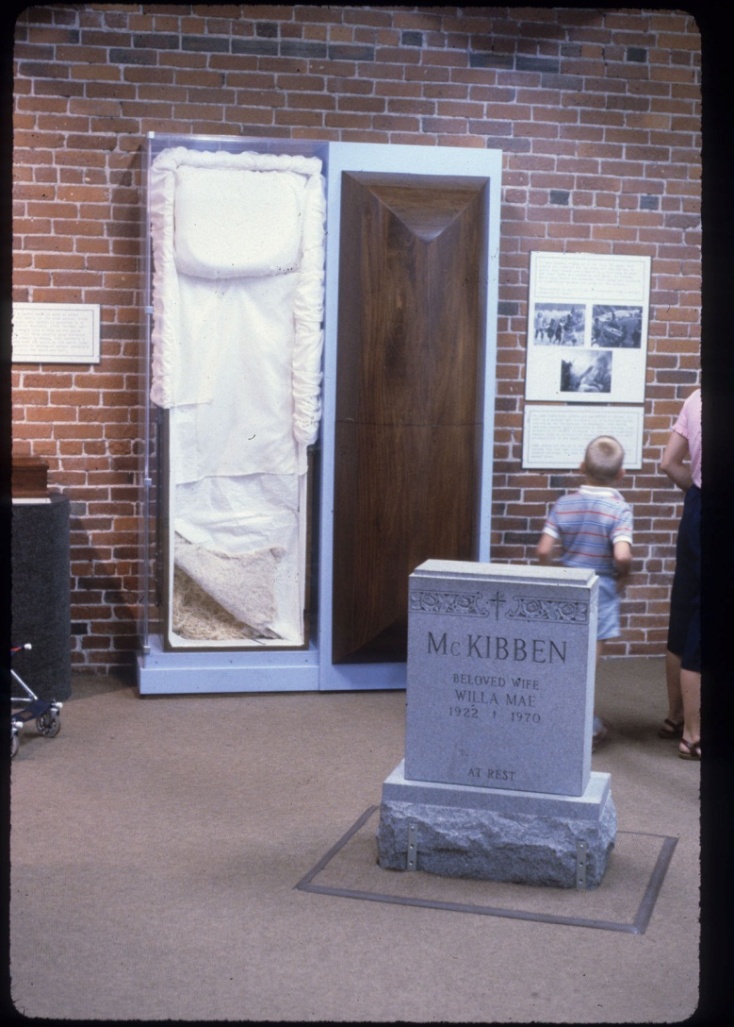
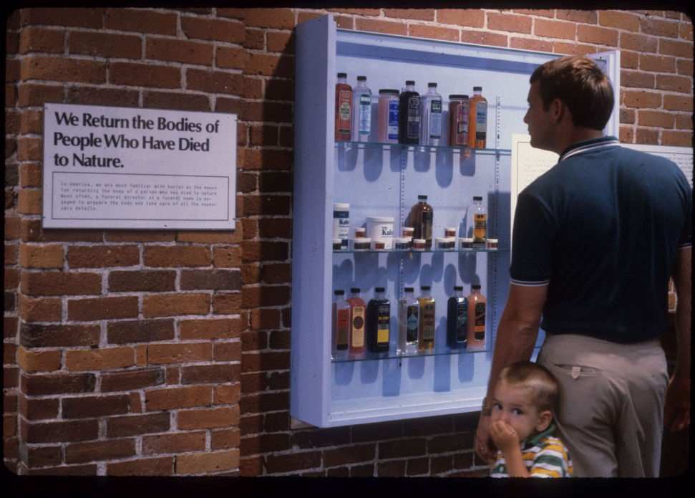
We return the Bodies of
People Who Have Died to Nature
This part of the exhibit allowed visitors to learn about processes and paraphernalia of the mortuary business.

Slide 16
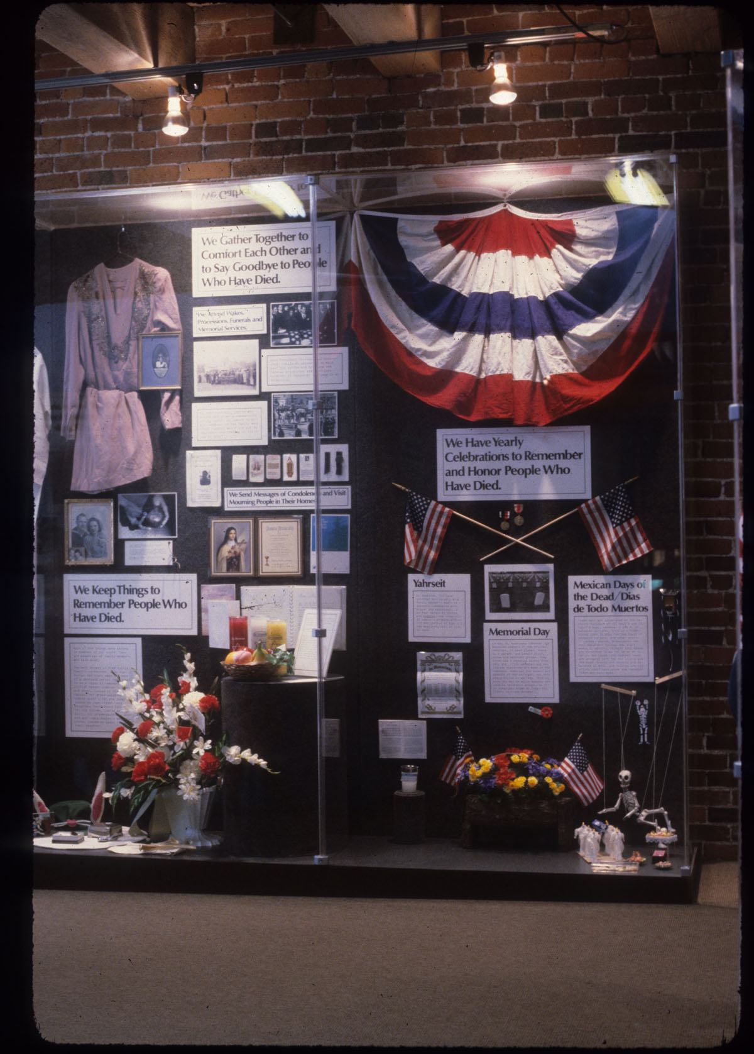
Memorials
A rich part of the exhibit displayed memorials from a variety of cultures.

Slide 17
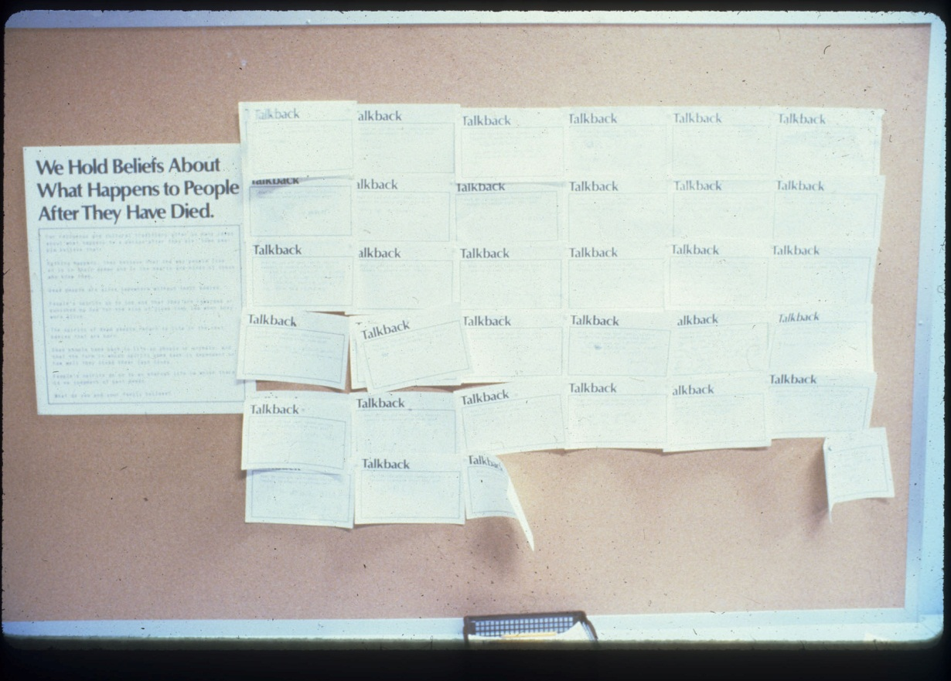
Talkback board
Many people took the opportunity to share their ideas and feelings on one of several Talkback Boards in the exhibit.

